Slide 1

Project Title – Air BNB Booking Analysis
Name : Vineetha V
Internship ID : INTERNSHIP_17546440516895be537820f
Apply ID : APPLY_1755265142689f3876af0e5

Slide 2

PROBLEM STATEMENT
Airbnb has changed the way people travel, giving guests more than just a place to stay—it offers experiences that feel personal and unique. Unlike hotels, it connects everyday hosts with travelers, opening doors to homes across the world.
In this project, we look at Airbnb bookings in New York City to understand what drives guest choices and host success. By exploring patterns in pricing, availability, and reviews, the goal is to find insights that can make the experience better for both hosts and travelers.

Slide 3
PROJECT DESCRIPTION
Airbnb has opened up a new way of traveling—staying in real homes, meeting real hosts, and enjoying places that feel more personal than a hotel room. From a city apartment to a quiet cabin, the platform gives travelers choices that fit different budgets and lifestyles.
This project takes a closer look at Airbnb bookings in New York City to see what the data reveals. By studying things like pricing, availability, and guest preferences, the aim is to spot patterns that explain why some stays work better than others. These insights can help hosts improve their listings and give travelers a smoother, more satisfying experience.

Slide 4

WHO ARE THE END USERS?
Travelers – people looking for affordable, unique, and comfortable stays.
Hosts – individuals who want to attract more guests and improve their earnings.
Airbnb as a platform – using insights to enhance the booking experience and trust between hosts and guests.
Researchers & Analysts – those studying travel trends, pricing, and customer behavior in the hospitality market.

Slide 5

Technology Used
Python – Data analysis, processing, and visualization
Pandas & NumPy – Data manipulation and numerical computations
Matplotlib & Seaborn – Data visualization and insights
Jupyter Notebook – Interactive coding and reporting
SQL – Data querying and extraction
Google Colab– Cloud-based analysis environment

Slide 6
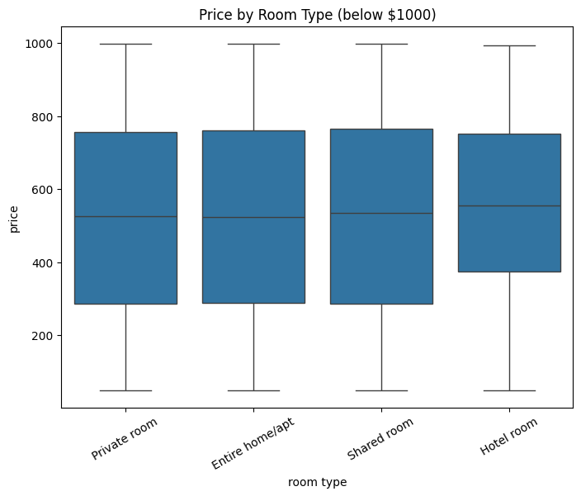
RESULTS1
Demo link:
https://tinyurl.com/yfwwk2ct

Slide 7
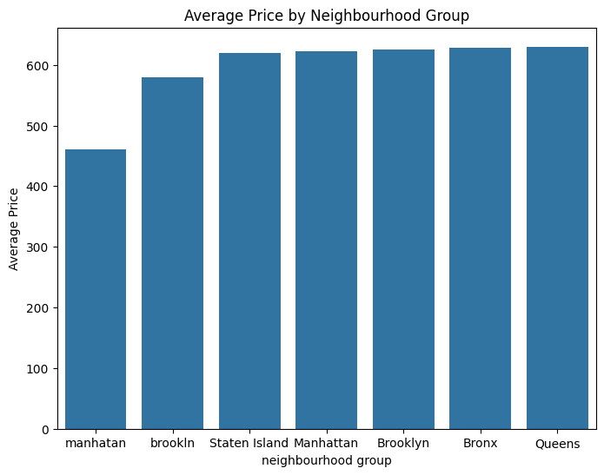
RESULTS2
Demo link:
https://tinyurl.com/yfwwk2ct

Slide 8
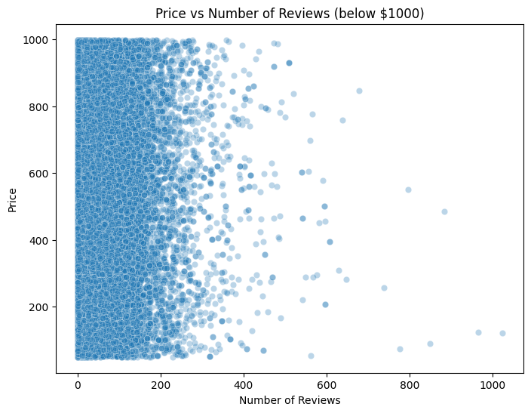
RESULTS3
Demo link:
https://tinyurl.com/yfwwk2ct

Slide 9
GitHub repository
LINK: https://github.com/vineetha0518/VOIS_AICTE_Oct2025_Vineetha_V

Slide 10
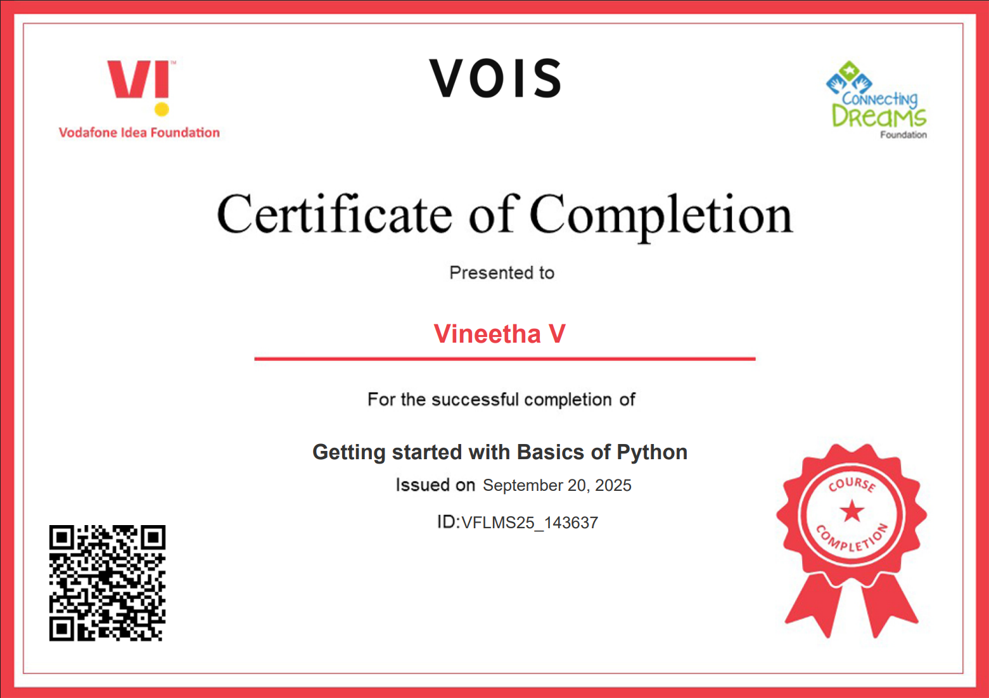
Getting started with Basics of Python Certificate

Slide 11
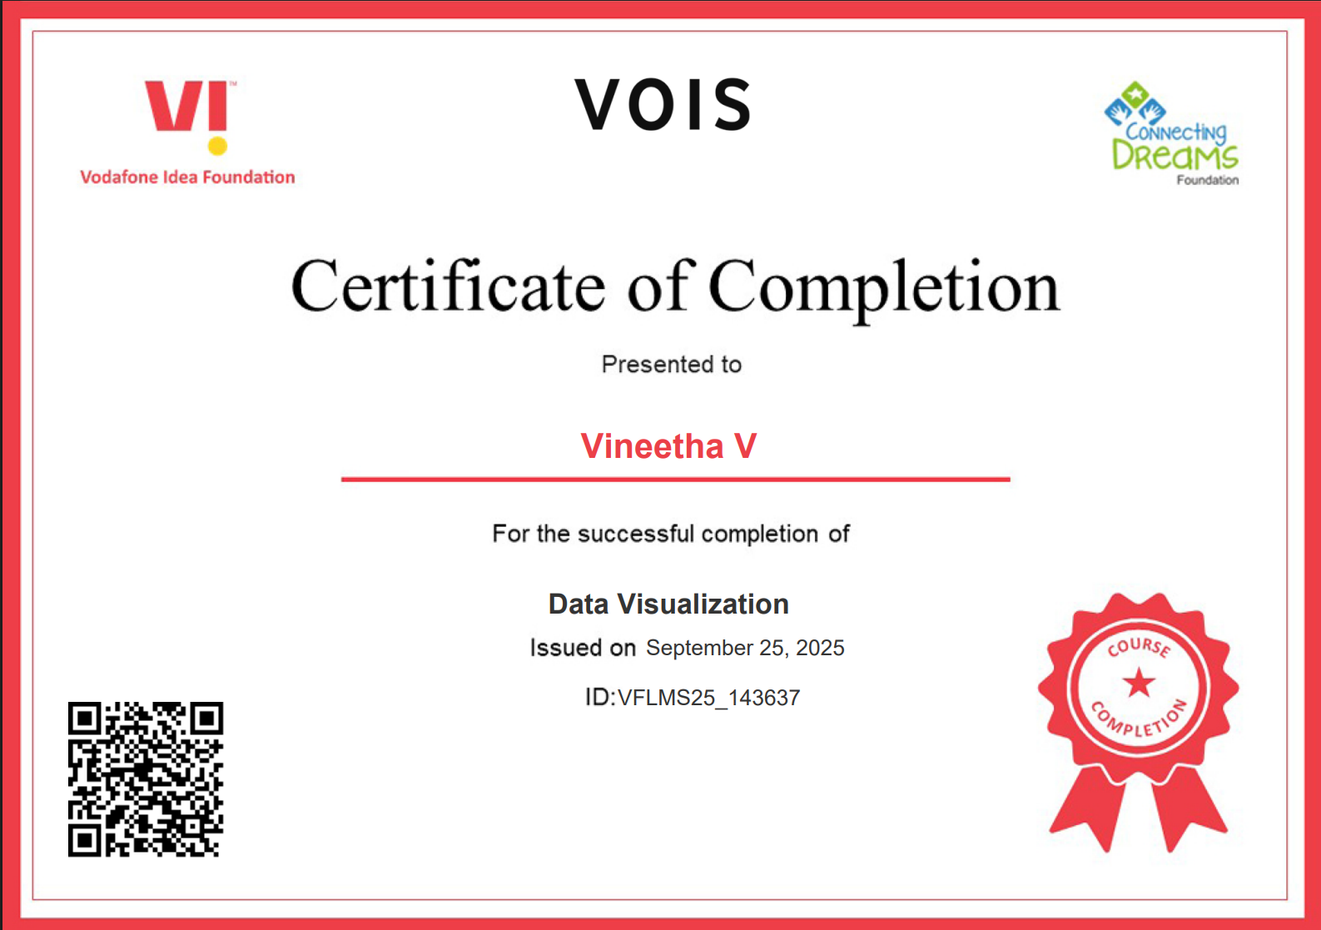
Data Visualization Certificate

Slide 12
Thank you
.
.

